Slide 1
Economic Sanctions and Militarized Interstate Disputes: Substitutes or Pre-Cursors?
Therese Anders, Jihyun Shin, Ming-Min Yang

Slide 2
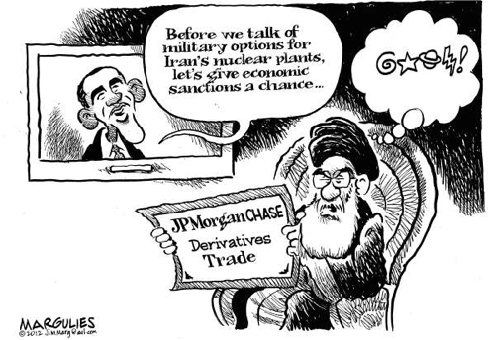
Research Question
When are sanctions substitutes of military force, and when do they become pre-cursors?

Slide 3
Sender
Sender
Implements Sanction
Uses Military Force
?
Target
Target
Notes:
We are interested in which factors make the use of miltiary force after a sanction has been implemented more likely?

Slide 4
Data Sources and Merging
Data set of imposed sanctions
N = 917
(N = 801 after deleting NA)
Threat and Imposition of Sanctions (TIES) Dataset
Militarized Interstate Dispute (MID) Dataset
Notes:
Merging was quite complicated.
Merged on basis of state pairs and overlap in the time of the sanction and the dispute.
Won’t go into details here.

Slide 5
Dependent Variable
Sender
= 1 if the sanction results in
Use of Force; War
= 0 if the sanction results in
No Military Action; Threat to Use Force; Display of Force
Uses Military Force
Target

Slide 6
Independent Variables I
Sanction Duration (in months)
Square of Sanction Duration
Ongoing Sanction Dummy (as of 2005)
Sanction Issue (both broad and narrow version)
Narrow: Contain Military Behavior; Destabilize Regime; Solve Territorial Dispute; Retaliate for Alliance or Alignment Choice; Terminate Support of Non-State Actors.
Broad: Deny Strategic Materials; End Weapons/Materials Proliferation.

Slide 7
Independent Variables II
Sender Cost (Minor, Major, Severe)
Target Cost (Minor, Major, Severe)
Sanction Starting Year
Carrots by Sender to the Target
Nature of termination
4 categories: Target capitulation; Sender capitulation; Stalemate; Negotiation.

Slide 8
regsubsets() for Model Selection
Notes:
We used the relative change of the measures for different numbers of predictors to assess the most appropriate model.

Slide 9
Model Selection II
Based on regsubsets(), we chose to include 7 predictors into our model.
MilDispute = SanctionDuration + SanctionDuration² + Ongoing + IssueNarrow + TargetCost + StartYear + Carrots
Training Data: N = 500
Testing Data: N = 301

Slide 10
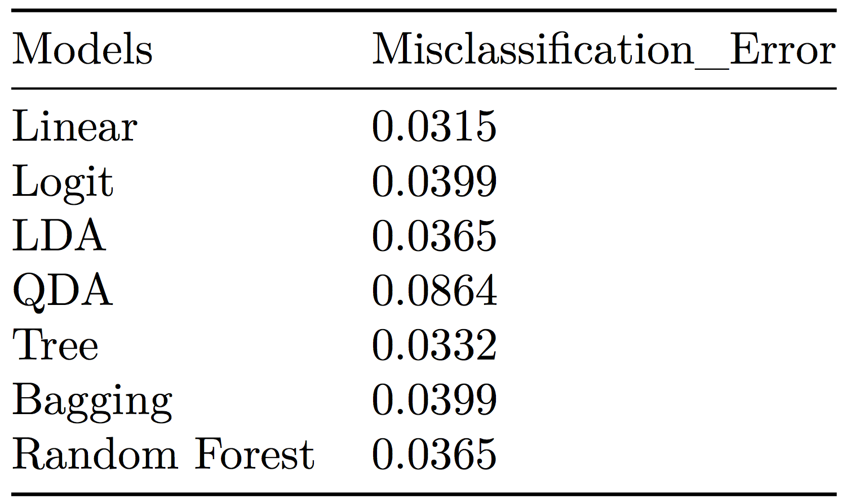
Comparing MSEs
Notes:
The linear model has the lowest MSE.
All other model MSEs, with the exception of QDA are very similar.

Slide 11
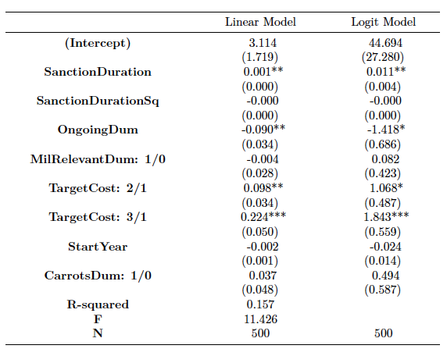
Comparing OLS and Logit

Slide 12
Most Powerful Predictor?
Notes:
According to the tree model (which has a very similar MSE to the logit model), Target Cost is the most powerful predictor.

Slide 13
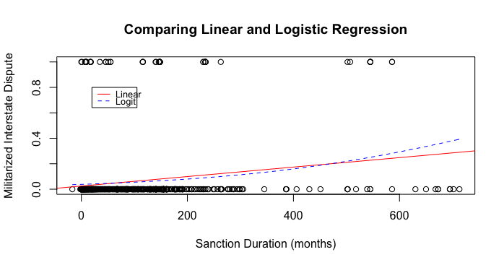
Assessing Different Models
The linear model has the lowest MSE.
However, our DV is binary. Therefore, linear regression is an inappropriate model choice.
Notes:
Neither of the lines in the graph describes the DV particularly well!!

Slide 14
Clustering the Duration Variable
Notes:
Univariate clustering in JMP.
Results of logit model: In comparison with the very shortest cluster (red), only the medium length clusters (green, blue) are found to statistically significantly increase the probability of the onset of a militarized interstate dispute.
All other variables remain virtually unchanged.

Slide 15
Conclusion
Precursor (+) | Substitute (-)
Duration: The longer the sanction, the more likely the use of force. | Ongoing: Sanctions that never ended are less likely to result in war.
Target cost: Higher costs for the target increase the likelihood of a military dispute.
Military disputes are very rare events – a hazard model might generally be more appropriate!
Notes:
Intuition behind the target cost variable:
higher target costs imply a higher gravity of the issue of contention.
If the sender state is willing to impose high-cost sanctions on the target, the sender might also be more willing to resort to the use of force.

